Slide 1


DONATION MANAGEMENT SYSTEM

Slide 2

TEAM MEMBERS
P. Amarnadh Reddy (24KB1A05CW)
P. Gowtham (24KB1A05DK)
P. Manoj (24KB1A05CT)
S. Sai Kaushal (24KB1A05GL)

Slide 3

INTRODUCTION
A Donation Management System helps organize and track donations.
Categorizes donations: Food, Clothes, and Money.
Simplifies data entry, storage, and retrieval.

Slide 4
PROBLEM STATEMENTS
Manual donation tracking is prone to errors.
Lack of centralized data management.
Need for simple file-based categorized donation system.

Slide 5
OBJECTIVES
Enable categorized donor entry (Food, Clothes, Money).
Maintain donor contact and donation details.
Store data persistently using file handling in C.

Slide 6
SYSTEM DESIGN OVERVIEW
User selects category and enters donor details.
Details stored in linked list per category.
All entries appended to 'donors.txt' file.
System displays donors and total money donated.

Slide 7
FEATURES
Supports three categories: Food, Clothes, Money.
Donar name, contact, and donation quantity.
Stores data persistently in text file.
Displays all donors and sums money donations.

Slide 8
1.createDonor(): Allocates and initializes donor node. 2.addDonor(): Adds node to list, determines unit, saves to file. 3.displayDonors(): Iterates all lists, shows details, calculates money total. 4.File I/O used to store data in 'donors.txt'.
Code logic

Slide 9
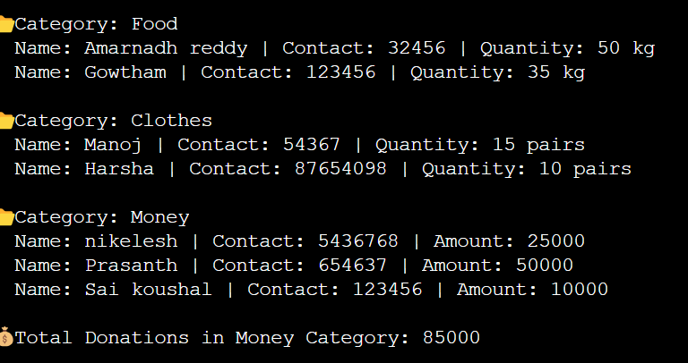
SAMPLE OUTPUT SCREEN
= Donation Management System =
1. Add Donor
2. Display All Donors
3. Exit
✅ Donor added to Clothes category and saved to file.

Slide 10
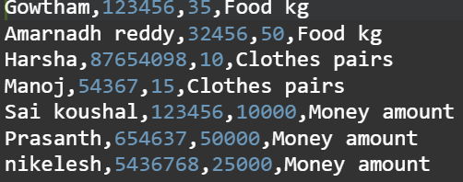
DETAILS OF THE DONORS

Slide 11
1.System simplifies donation tracking. 2.Categorized and structured data handling. 3.Basic file-based system with expandable scope.
CONCLUSION

Slide 12


Slide 13
Thank You

